Slide 1
Week 5 Presentation
Group 1:
Jibin Mathews Maritza Torres

Slide 2
Objective
Make a course for the Lab 1 Group that is heavy on sensing and signaling.
Rover must complete the course in 60 seconds
Track Position of Rover and Determine speed required to finish on time
Course communication for various actions
IR and Sound

Slide 3
Deliverables
Template Matching
Track Materials Acquired
Communication progress

Slide 4
Track Elements
Utilize Metallic Strip as path for rover to follow
Use IR Sensor and Sound Communication to Decode/ Encode Information with Rover
Track Rovers location

Slide 5


Template Matching
Find a reference template within a given image.
Overlap the template and measure the difference between point
When Difference is smallest then it is a match
Mathematical Terms
Sum of (Image - Template) ^2 : Sum of Squared Differences
When this equals zero then there is a match
Minimize (Sum of Squared Differences)
Maximized (Cross- Correlation)
(Shree K. Nayar, 2021)

Slide 6
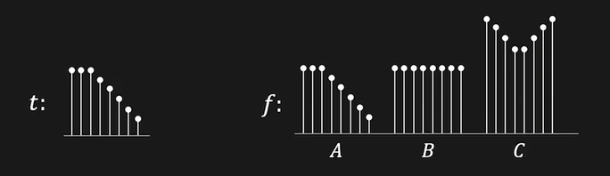
Template Matching Example
Cross Correlation Highest at C then B then A due to the higher values contained
For programming purposes we need A to be maximum to get the correct match
(Shree K. Nayar, 2021)

Slide 7
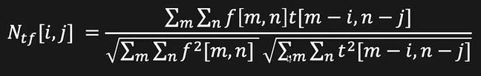
Cross Correlation Solution
Normalized Cross Correlation
Energy in overlap of template in image
Energy of the template itself
(Shree K. Nayar, 2021)
This allows the cross correlation to ignore adjustments made to lighting and looks for pattern

Slide 8
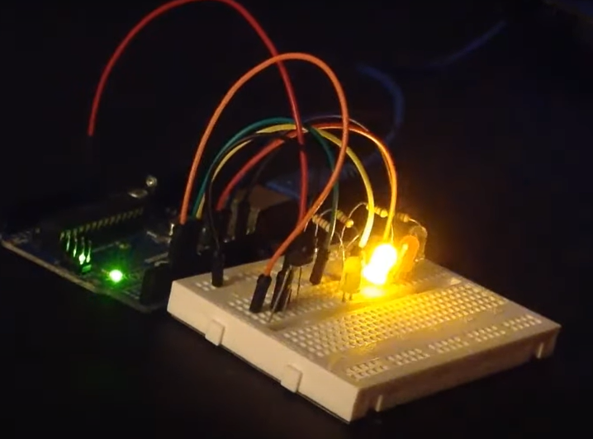
IR Sensor

Slide 9
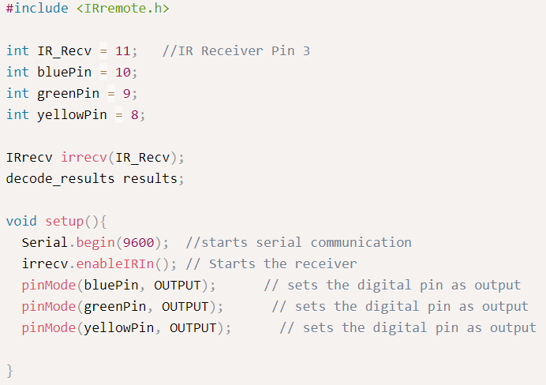
Snippet of Code for IR Sensor using Arduino IDE

Slide 10
Budget
Budget Lab 2 Project | Cost: | Total Spent:
Raspberry Pi 4 Model B | $129.99 | $0.00 |  | Material Costs | Cost: | Total Spent:
IR Receiver Module | $7.40 | $7.40 |  |  | $250.84 | $120.85
Misc. (LED, Resistors, Jumper wires) | $10.00 | $10.00
Onn. Webcam | $27.00 | $27.00 |  | Totals | Total Cost: | Actual Cost:
Elegoo Uno R3 (arduino) | $16.99 | $16.99 |  |  | $250.84 | $120.85
Buzzer | $1.04 | $1.04
USB Type B - A cable connector | $29.99 | $29.99
Breadboards | $9.99 | $9.99
2N9304 Transistor | $0.44 | $0.44
Track Elements
Whiteboard | $13 | $13.00
Metallic Tape | $5.00 | $5.00

Slide 11
Gantt Chart
Lab 2 | Week 1 | Week 2 | Week 3 | Week 4 | Week 5 | Week 6 | Week 7
Hardware
Research
Path
Sensors
IR Receiver/ Transmitter
Buzzer
Object Tracking w/ Camera
Software
Research
Download/ Install: Python/ OpenCV
Actual Coding
Track

Slide 12
Next Week's Deliverables
Track Built
Progress on Algorithm for Rover Tracking

Slide 13
References
OpenCV: Real time road lane detection. GeeksforGeeks. (2022, January 18). Retrieved June 28, 2022, from https://www.geeksforgeeks.org/opencv-real-time-road-lane-detection/
chrome-extension://efaidnbmnnnibpcajpcglclefindmkaj/https://www.aatc.tw/images/pdf/20200508291bd.pdf
https://www.aatc.tw/products.php?lang=en&id=635
Nayar, S. K. (2021, March 1). Template matching by Correlation | Image processing I. YouTube. Retrieved July 12, 2022, from https://www.youtube.com/watch?v=1_hwFc8PXVE&ab_channel=FirstPrinciplesofComputerVision
Tomasi, C., & Manduchi, R. (n.d.). Bilateral filtering for gray and color images. IEEE Xplore. Retrieved July 12, 2022, from https://ieeexplore.ieee.org/document/710815
Wilhelm, M., Nutter, B., Long, R., & Antani, S. (n.d.). Linear Array image analysis for automated detection of human papillomavirus. IEEE Xplore. Retrieved July 12, 2022, from https://ieeexplore.ieee.org/abstract/document/5255266
https://wiki.dfrobot.com/DIGITAL_IR_Transmitter_Module__SKU_DFR0095_

Slide 14
Questions
?

